Slide 1
Introduction to Arduino
Rochester MakerSpace
2021
Notes:
Welcome
Introductions

Slide 2
Class Objectives
Become familiar with Arduino hardware and software
Be aware of the range of Arduino-supported boards and how to choose one for your project
Understand how to connect and operate Arduino hardware from a PC or Mac
Understand how to create and run a program on an Arduino
Understand how to control a simple circuit from an Arduino
Get a starter list of resources for learning more
Be excited by the possibilities!

Slide 3
Class notes and code
All the class notes and code can be downloaded from GitHub:
https://github.com/RochesterMakerSpace/ArduinoClass
Pull down the green “Code” button and select “Download ZIP”

Slide 4
Computers, Microcontrollers, Arduino
Conventional computers can be described by 5 main components:
CPU – the Central Processing Unit executes instructions
Program memory – the instructions
Data memory – the data
I/O interfaces and devices – connecting disks, screens, keyboards, mice, etc.
Software - Operating system, utility programs, applications
Microcontrollers are a computers on a chip typically including a CPU, and program and data memory with connectors for General Purpose Input and Output (GPIO).
Arduino is an open-source board design, originally designed in 2006, that is combined with a free, basic development environment

Slide 5
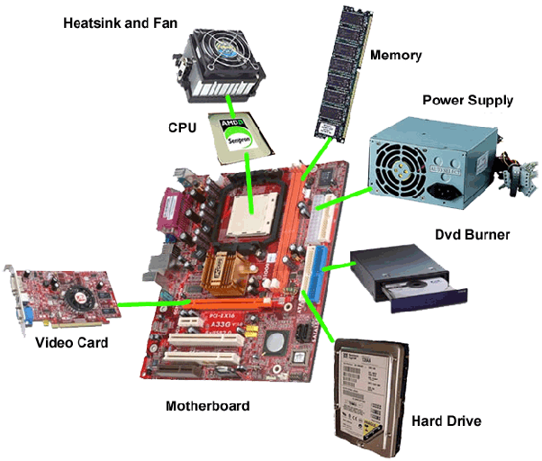
Microcontrollers → Computer systems

Slide 6
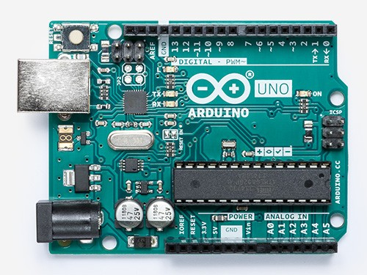
Arduino Uno R3
The canonical Arduino design
Focus is on experimentation and learning
A simple, low-cost, small computer
Genuine: $22, Clone: $11
Modest processing power (16 Mhz)
Small space for code (32KB)
Small space for data (2KB)
Wide range of GPIO connectivity options for devices or circuits
Easy USB connection and good, free software development environment
Huge community of ‘makers’ providing videos, tutorials, examples, projects, devices, advice

Slide 7
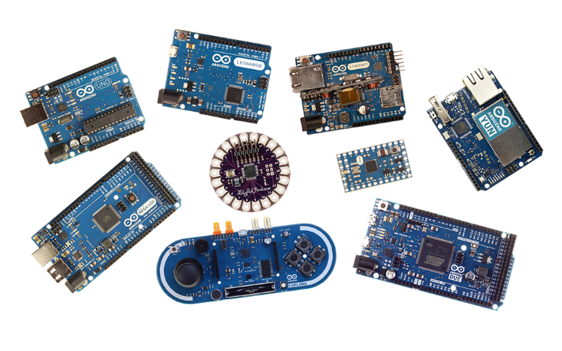
Many Arduino variants
Faster processor
Bigger programs
More data
More pins to connect devices
More portable
Different form factor

Slide 8
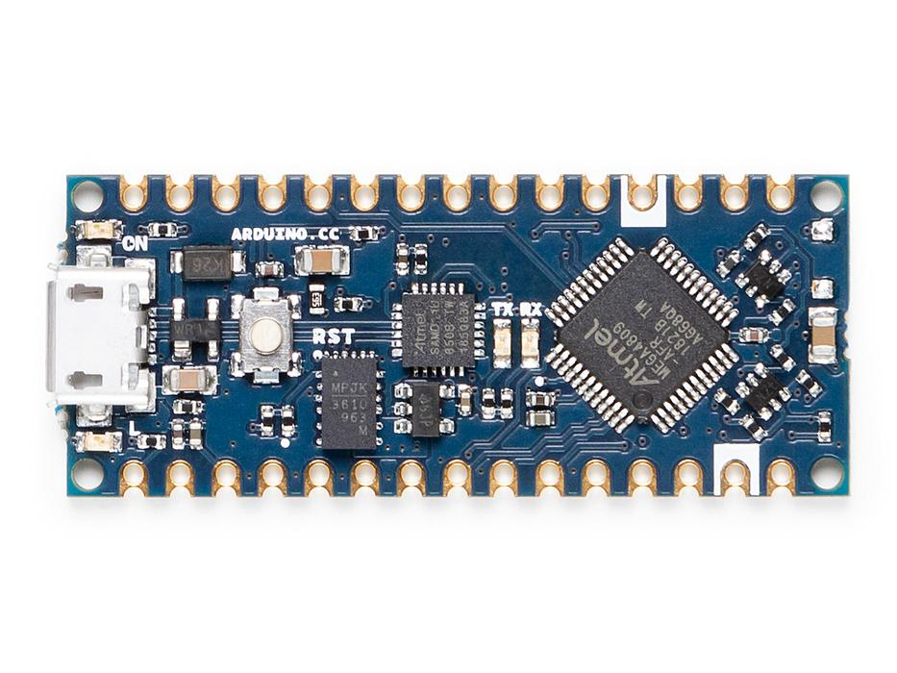
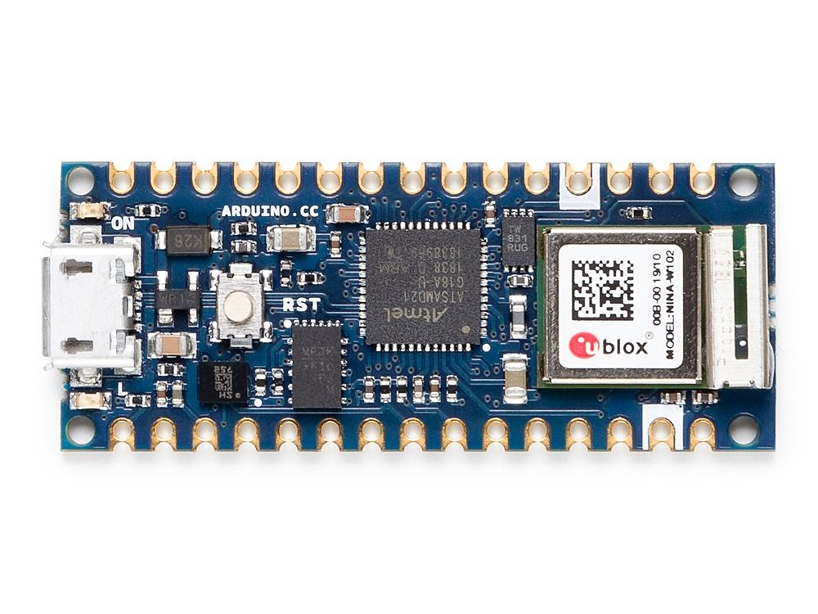
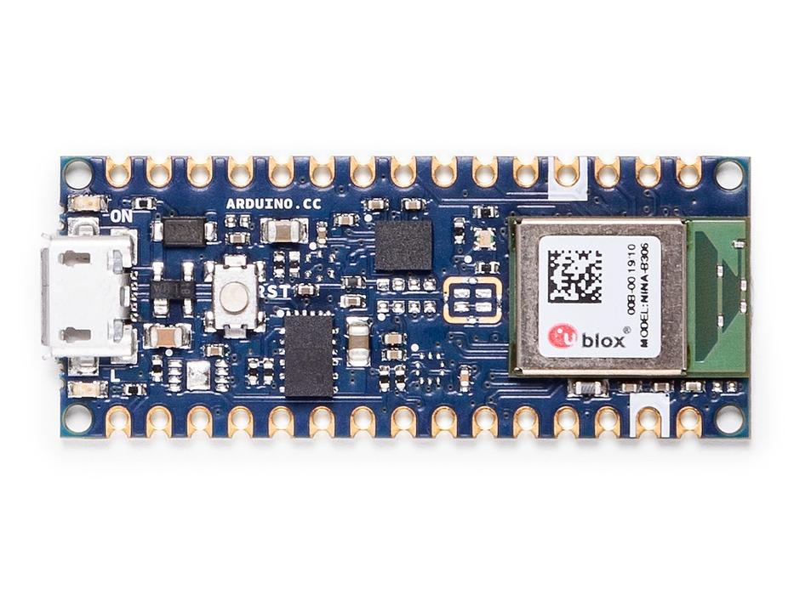
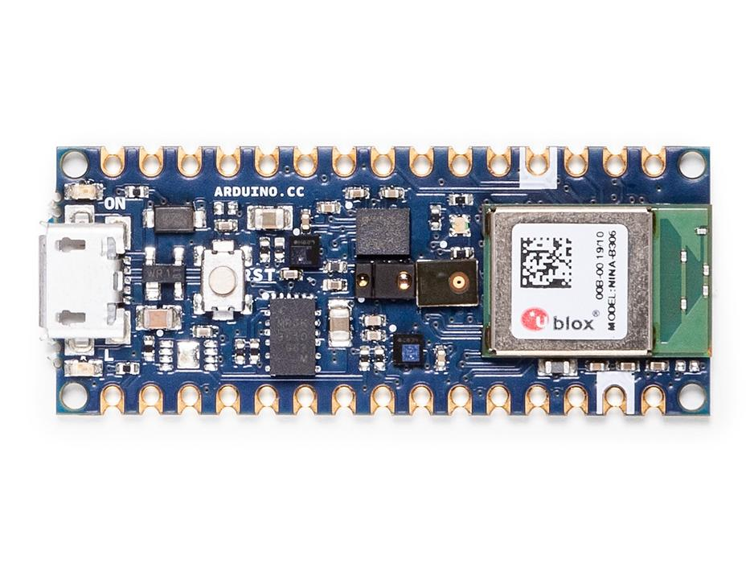
New Arduino Nanos
Arduino Nano Every
Arduino Nano Every $11.90
ATMega4809 20 Mhz
48 KB Flash, 6 KB RAM
Arduino Nano 33 IoT $18.40
SAMD21, 32-bit, 48 Mhz
256 KB Flash, 32 KB RAM
WiFi, Bluetooth, BLE, 6 Axis IMU
Arduino Nano 33 BLE $20.20
nRF52840, 32-bit, 64 Mhz
1 MB Flash, 256 KB RAM
Bluetooth, BLE, 9 Axis IMU
Arduino Nano 33 Sense $31.10
nRF52840, 32-bit, 64 Mhz
1 MB Flash, 256 KB RAM
Bluetooth, BLE, 9 Axis IMU
Humitity, Temp, Pressure, Mic, gesture ,proximity, light sensors
Arduino Nano 33 IoT
Arduino Nano 33 BLE
Arduino Nano 33 Sense

Slide 9
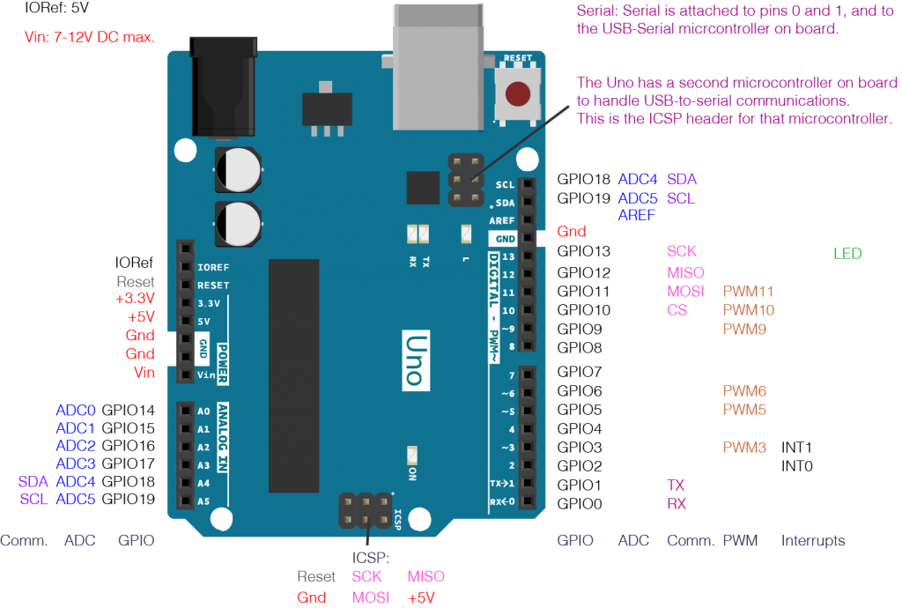
Arduino GPIO
Simple direct connection for digital input and output
Simple direct connection for analog input
Onboard pulse width modulation (PWM)
4 ways to connect to other chips:
GPIO – Digital I/O or Analog Input
I2C – Inter-Integrated-Circuit
SPI – Serial Peripheral Interface
Serial – asynchronous serial

Slide 10
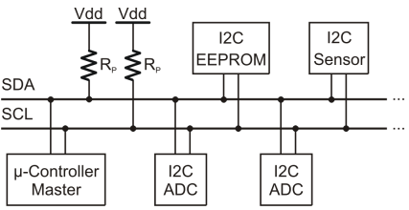
I2C
I²C ( Inter-Integrated Circuit ), pronounced I-squared-C , is a synchronous , multi-master, multi-slave , packet switched , single-ended , serial computer bus invented in 1982 by Philips Semiconductor (now NXP Semiconductors ). It is widely used for attaching lower-speed peripheral ICs to processors and microcontrollers in short-distance, intra-board communication. Alternatively I²C is spelled I2C (pronounced I-two-C) or IIC (pronounced I-I-C).
Wikipedia

Slide 11
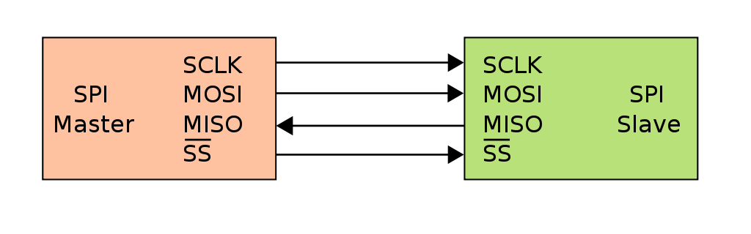
SPI
The Serial Peripheral Interface (SPI) is a synchronous serial communication interface specification used for short distance communication, primarily in embedded systems. The interface was developed by Motorola in the mid 1980s and has become a de facto standard. Typical applications include Secure Digital cards and liquid crystal displays.
Wikipedia

Slide 12
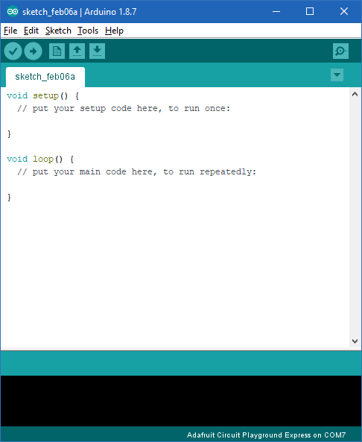
Arduino Integrated Development Environment (IDE)
Free download from https://www.arduino.cc/en/Main/Software
Simple, fixed program structure
Uses a programming language that is a simplified variant of c++
Support for other processors, ESP8266, STM32, Pi Pico, etc.
Alternatives:
Arduino IDE 2.0
Platform IO (VS Code/Atom)

Slide 13
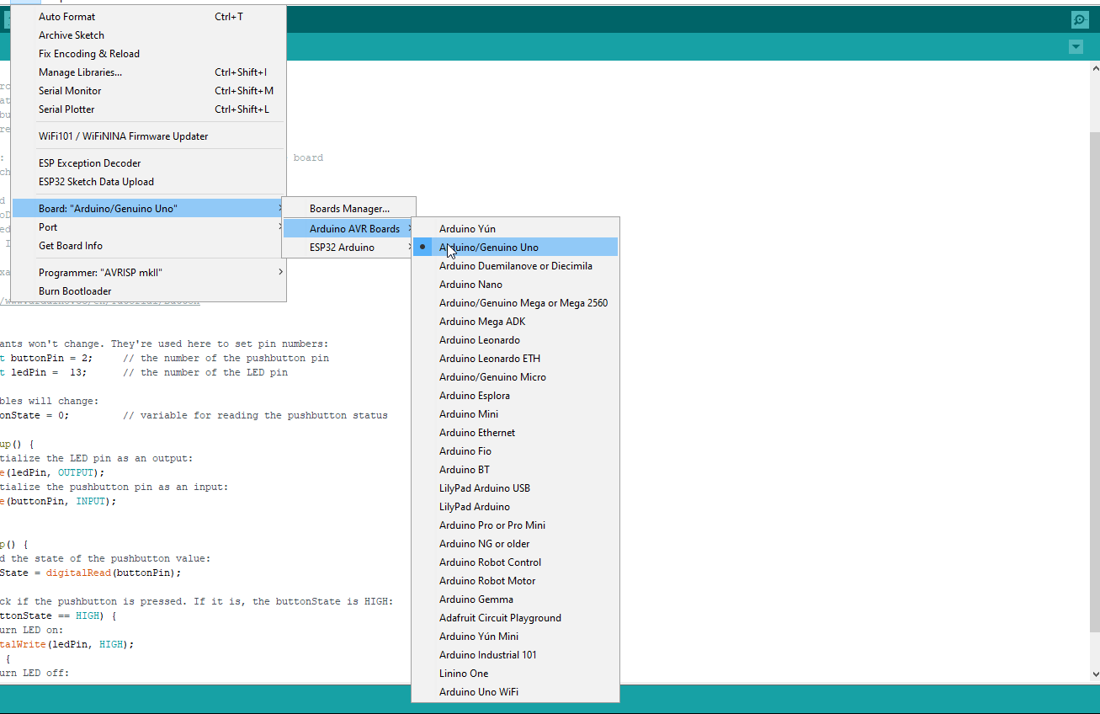
Arduino Integrated Development Environment (IDE)
Change board type
Arduino UNO or Arduino UNO clone
Tools|Board|Arduino AVR Boards|Arduino\Genuine UNO
Arduino Leonardo or Arduino Leonardo clone (Velleman – white board)
Tools|Board|Arduino AVR Boards|Arduino Leonardo

Slide 14
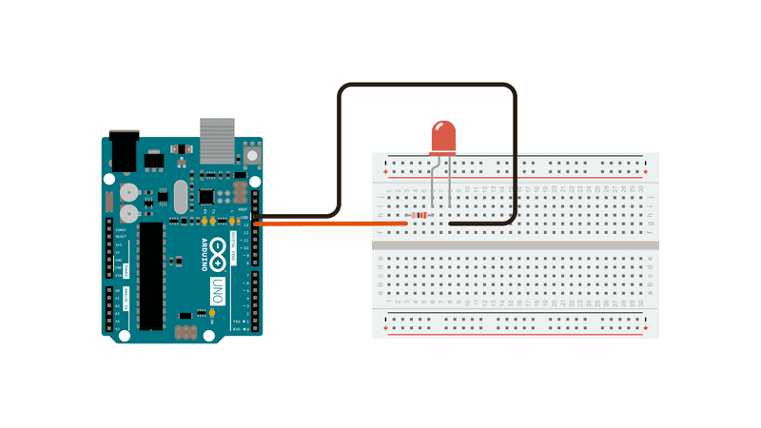
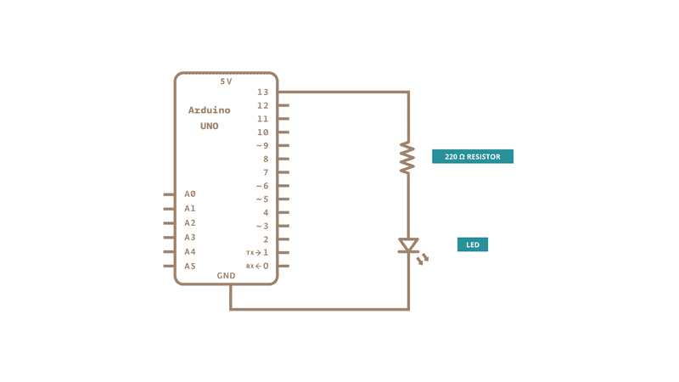
Sketches and Circuits
Can use Built In LED connected to pin 13 instead of external LED
Blink (File|Examples|01.Basics|Blink)
Focus: basic code of a sketch
Experiment: change the rate of blinking

Slide 15
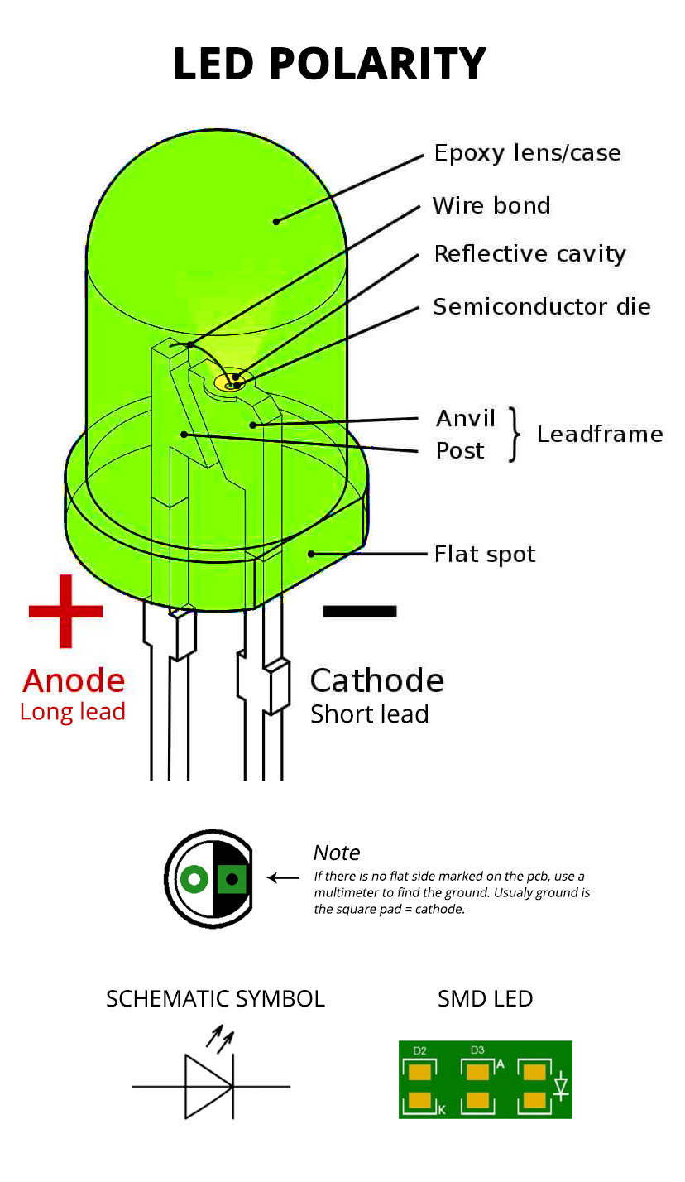
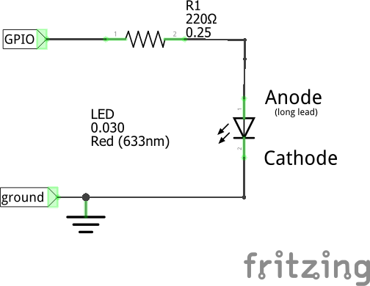
LED Polarity

Slide 16
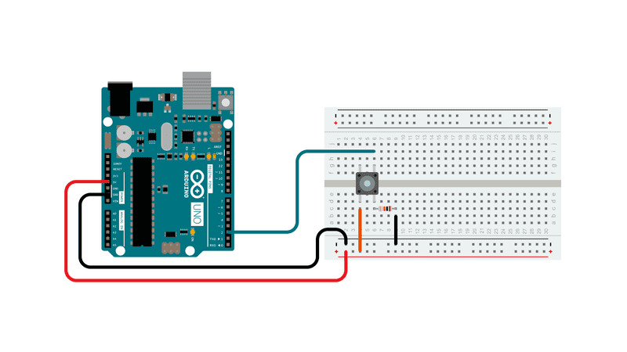
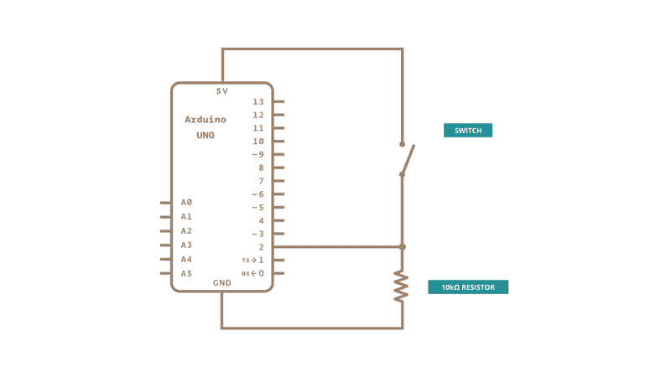
Sketches and Circuits
Can use Built In LED connected to pin 13
Button (File|Examples|01.Digital|Button)
Focus: breadboarding, variables
Experiment: reverse the effect of a button press

Slide 17

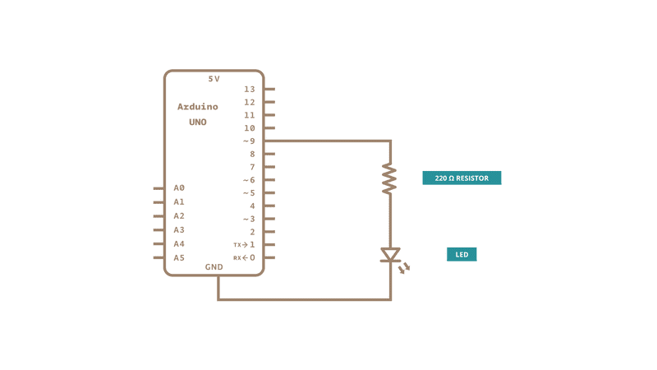
Sketches and Circuits
Fade (File|Examples|01.Basics|Fade)
Focus: PWM
Experiment: change the variables

Slide 18
Fade LED PWM

Slide 19
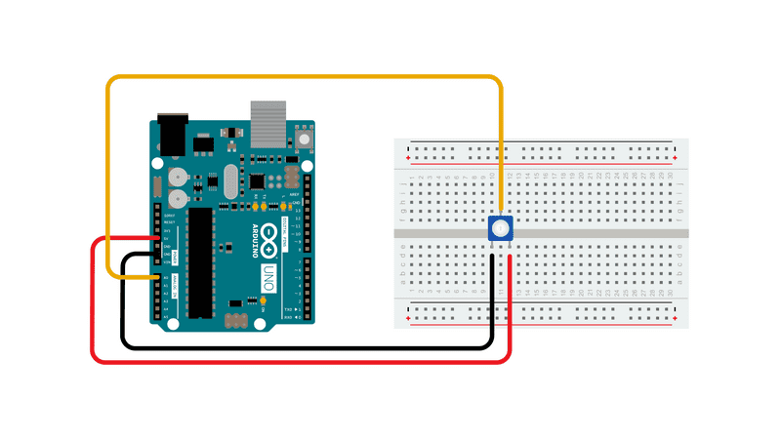
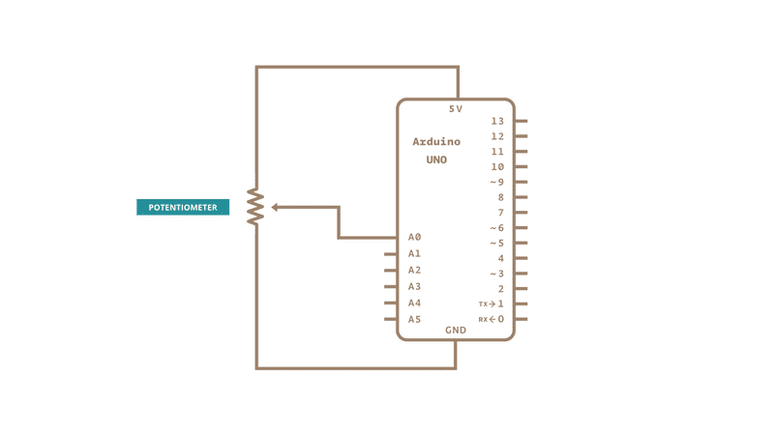
Sketches and Circuits
ReadAnalogVoltage (File|Examples|01.Basics|ReadAnalogVoltage)
Focus: analog input, monitor/plotter
Experiment: convert to use the 3.3v pin
Use function to convert sensor value to voltage:
float SensorToVoltage(int sensor)
{
return sensor * (5.0/1023.0);
}

Slide 20
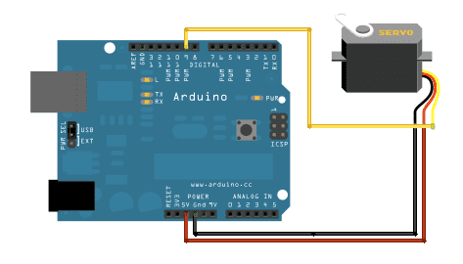
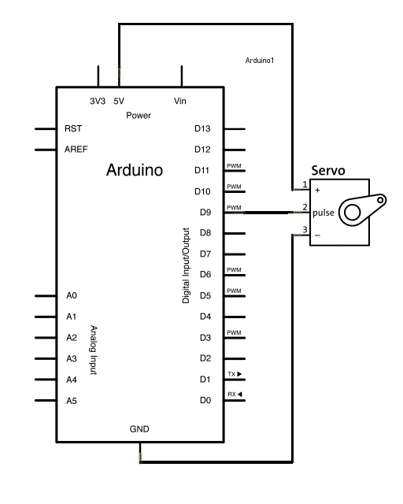
Sketches and Circuits
Sweep (File|Examples|Servo|Swee[)
Focus: #includes, motor control
Experiment: restrict the servo range of motion

Slide 21
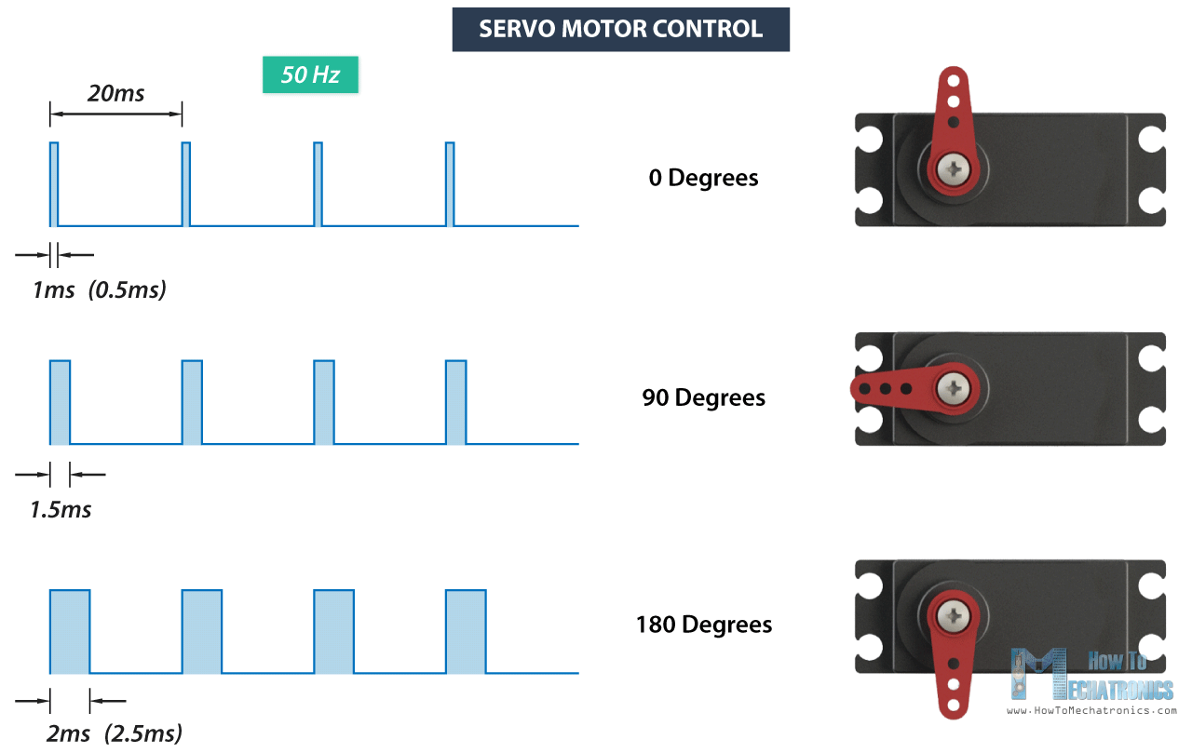
Servo PWM

Slide 22
Sketches and Circuits
Can use Built In LED connected to pin 13 instead of external LED
BlinkWithoutDelay (File|Examples|02.Digital|BlinkWithoutDelay)
Focus: code execution timing
Experiment: print to the serial monitor at the same time

Slide 23
Sketches and Circuits
Can use Built In LED connected to pin 13 instead of external LED
Debounce (File|Examples|02.Digital|Debounce)
Focus: the mechanical world
Experiment: how short can your delay be without flickering the led?

Slide 24
Resources
https://www.instructables.com/id/Arduino-Projects/ A great source of inspiration Shows many cool projects you can accomplish with an Arduino
Introduction to Arduino: A piece of cake! Alan G. Smith (alan@introtoarduino.com) Hardcopy available at http://www.amazon.com The most recent PDF is free at http://www.introtoarduino.com
https://www.arduino.cc The official web site for Arduino Tutorials, documentation, example projects, shop
https://www.adafruit.com A DIY site loaded with Arduino and Raspberry Pi products Tutorials, step-by-step instructions, example projects, shop
https://www.sparkfun.com/ An electronics retailer with lots of Arduino and Raspberry Pi products
https://www.pololu.com/ An online retailer with lots of robotics components
https://www.seeedstudio.com/ An online retailer of project components
https:// blog.tinkercad.com/official-guide-to-tinkercad-circuits / Cloud-based 3D CAD and Circuit design tool

Slide 25
Nightlight example
Night Light – a simple circuit to switch on an LED when it gets dark
Open|Maker/Documents/ArduinoClass/nightlight/nightlight.ino
Demonstrates use of analog input and digital output
Demo: https://www.youtube.com/watch?v=2GqKbUyhUww

Slide 26
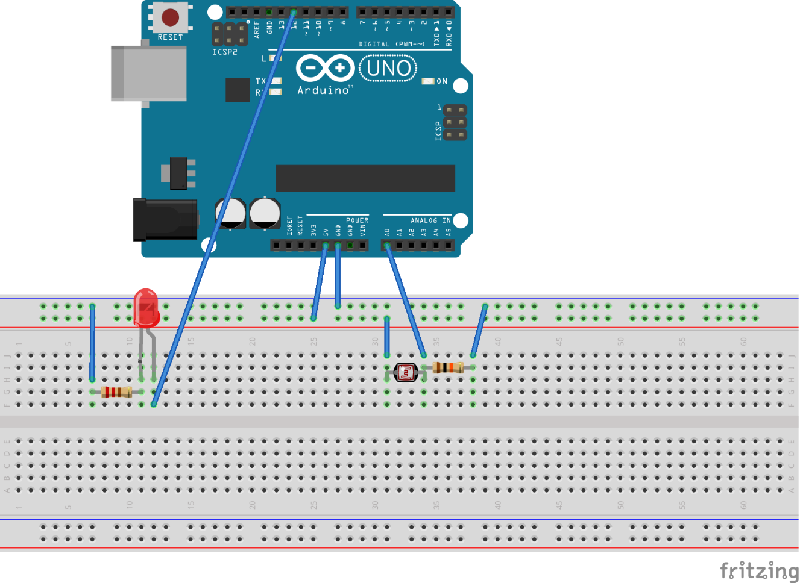
Nightlight example - Breadboard

Slide 27
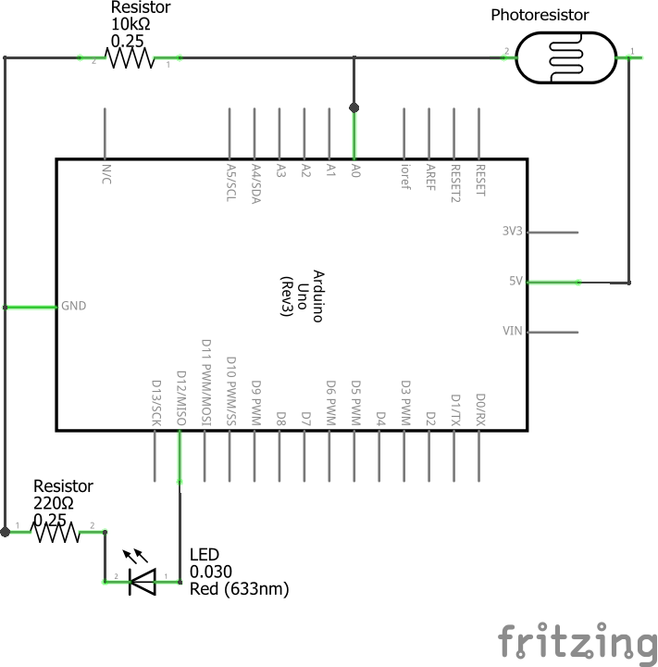
Nightlight example - Schematic

